Slide 1
AS91883(1.7) & AS91884(1.8) Documentation
Joseph Surrey

Slide 2
Lucky Unicorn
Link to GitHub Repository: https://github.com/josephsurrey/Lucky-Unicorns
Links to Trello board / project management tools: https://trello.com/invite/b/I9pedhKD/ATTIfc627988032ea2f7b44bdbb13c7c132b5613F0BA/lucky-unicorn
Link to final version of your program: [here]
Ensure you have made these links ‘public’ so that they are open to anyone, including the marker. The link to your program is the final outcome of this whole project – your finished program.

Slide 3
Describe relevant Implications:
Additional rows can be added by clicking in the last cell and then using the Tab key
 | Describe the implication and give an example
Functionality | Functionality is about ensuring that the program works as expected. It should work for expected, boundary and unexpected cases. For example, if my program asks how many rounds a user wants, it should work for expected input like '2' or boundary input like '1’ but it should not crash if the user enters something invalid like '0’ or '0.5' or 'one'
Usability | Usability is about how easily the end user can get the program to do what it is supposed to do. It deals with issues like making instructions and error messages clear and easy for users to understand. It is important to minimise or eliminate any frustration.
Aesthetics | Aesthetics is about the program's overall appearance. A program which looks good because it includes well spaced instructions, prompts and 'decoration' around key messages is going to be more aesthetically pleasing than one which is composed of unspaced plain text.
Social | The social implications of a computer program are about the affect it might have on users, the wider community, and society as a whole. For example, computer programs which are based around a gambling game can have a negative impact on society if there are no safeguards in place to limit users from excessive losses. It is also important to use clear, unambiguous instructions and feedback which is culturally neutral and inoffensive.
Future proofing | Future proofing is about making a program which is flexible and adaptable and easy to modify later if necessary. The code needs to be well set out and commented so that another programmer can make changes easily at some future time. Someone who wants to modify my code in the future needs to understand the purpose and reasoning behind different parts of the code. Also, its important to use constants rather than literals — to minimise the number of places where changes have to be made.
Notes:
Additional rows can be added by clicking in the last cell and then using the Tab key

Slide 4
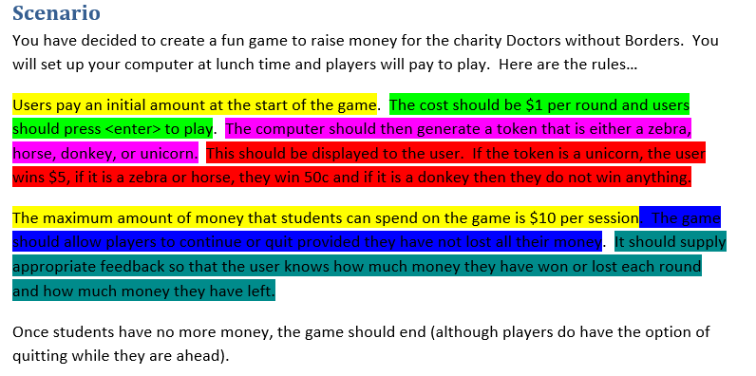
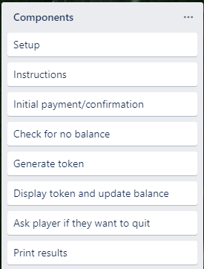
Decomposition:
Paste screenshots of your initial Trello board / task decomposition on this slide. If you have a long list, you might need to break it up into several slides.
Notes:
Paste screenshots of your initial Trello board / task decomposition on this slide. If you have a long list, you might need to break it up into several slides.

Slide 5
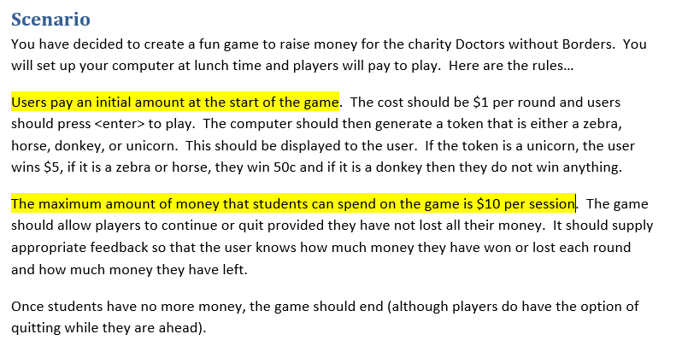
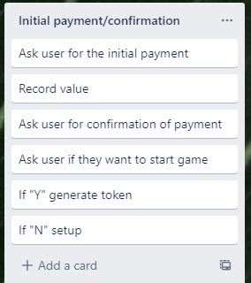
[Component name] (Trello screenshot)

Slide 6
[Component name] - Test Plan
Additional rows can be added by clicking in the last cell and then using the Tab key
Test Cases - input | Expected output
1 | Balance = 1
10 | Balance = 10
11 | Print(“Max amount to play with is $10”)
Ten | Invalid input
Notes:
Additional rows can be added by clicking in the last cell and then using the Tab key

Slide 7
[Component name] - Test Plan – confirm input
Additional rows can be added by clicking in the last cell and then using the Tab key
Test Cases - input | Expected output
Y | Ask if user wants to start game
y | Ask if user wants to start game
N | Ask user for initial payment
n | Ask user for initial payment
Hello | Invalid input
Notes:
Additional rows can be added by clicking in the last cell and then using the Tab key

Slide 8
[Component name] - Test Plan – ask if user wants to start game
Additional rows can be added by clicking in the last cell and then using the Tab key
Test Cases - input | Expected output
Y | start game
y | start game
N | setup
n | setup
Hello | Invalid input
Notes:
Additional rows can be added by clicking in the last cell and then using the Tab key

Slide 9
[Component name]: Trialling
NOTE: Trialling needs to happen for at least 2 of your components but is not necessary for ALL components.
Trialling is not the same as testing. Trialling is about finding different ways of building the same component. Show evidence of your trialling here. Select one of your trials for further development and give reasons for your choice.
Notes:
NOTE: Trialling needs to happen for at least 2 of your components but is not necessary for ALL components.
Trialling is not the same as testing. Trialling is about finding different ways of building the same component. Show evidence of your trialling here. Select one of your trials for further development and give reasons for your choice.

Slide 10
[Component name]: Testing
You must show the results of testing. For each component, include a screenshot proving it works. You can also include notes about each test.
Notes:
You must show the results of testing. For each component, include a screenshot proving it works. You can also include notes about each test.

Slide 11
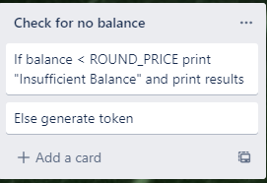
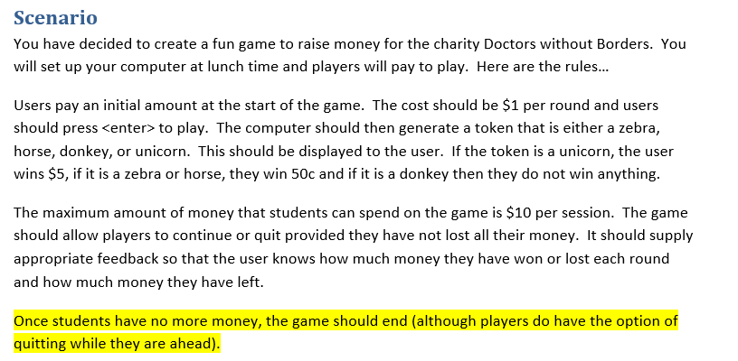
[Component name] (Trello screenshot)

Slide 12
[Component name] - Test Plan
Additional rows can be added by clicking in the last cell and then using the Tab key
Test Cases - input | Expected output
Notes:
Additional rows can be added by clicking in the last cell and then using the Tab key

Slide 13
[Component name]: Trialling
NOTE: Trialling needs to happen for at least 2 of your components but is not necessary for ALL components.
Trialling is not the same as testing. Trialling is about finding different ways of building the same component. Show evidence of your trialling here. Select one of your trials for further development and give reasons for your choice.
Notes:
NOTE: Trialling needs to happen for at least 2 of your components but is not necessary for ALL components.
Trialling is not the same as testing. Trialling is about finding different ways of building the same component. Show evidence of your trialling here. Select one of your trials for further development and give reasons for your choice.

Slide 14
[Component name]: Testing
You must show the results of testing. For each component, include a screenshot proving it works. You can also include notes about each test.
Notes:
You must show the results of testing. For each component, include a screenshot proving it works. You can also include notes about each test.

Slide 15
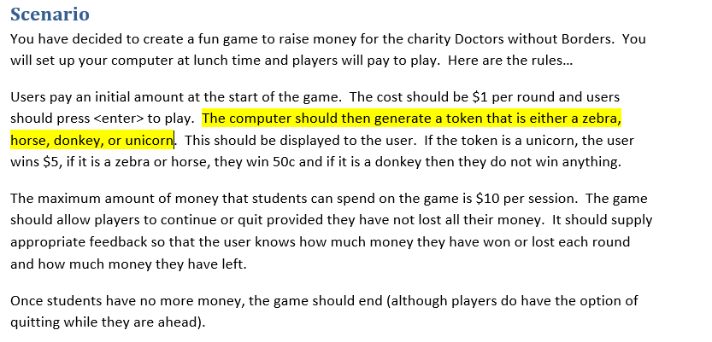
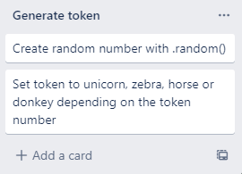
[Component name] (Trello screenshot)

Slide 16
[Component name] - Test Plan
Additional rows can be added by clicking in the last cell and then using the Tab key
Test Cases - input | Expected output
Notes:
Additional rows can be added by clicking in the last cell and then using the Tab key

Slide 17
[Component name]: Trialling
NOTE: Trialling needs to happen for at least 2 of your components but is not necessary for ALL components.
Trialling is not the same as testing. Trialling is about finding different ways of building the same component. Show evidence of your trialling here. Select one of your trials for further development and give reasons for your choice.
Notes:
NOTE: Trialling needs to happen for at least 2 of your components but is not necessary for ALL components.
Trialling is not the same as testing. Trialling is about finding different ways of building the same component. Show evidence of your trialling here. Select one of your trials for further development and give reasons for your choice.

Slide 18
[Component name]: Testing
You must show the results of testing. For each component, include a screenshot proving it works. You can also include notes about each test.
Notes:
You must show the results of testing. For each component, include a screenshot proving it works. You can also include notes about each test.

Slide 19
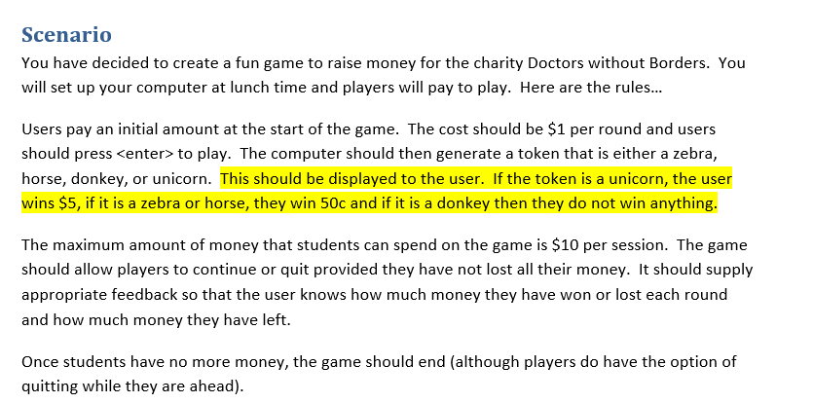
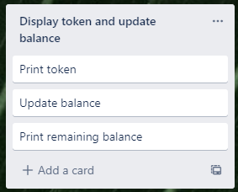
[Component name] (Trello screenshot)

Slide 20
[Component name] - Test Plan
Additional rows can be added by clicking in the last cell and then using the Tab key
Test Cases - input | Expected output
Notes:
Additional rows can be added by clicking in the last cell and then using the Tab key

Slide 21
[Component name]: Trialling
NOTE: Trialling needs to happen for at least 2 of your components but is not necessary for ALL components.
Trialling is not the same as testing. Trialling is about finding different ways of building the same component. Show evidence of your trialling here. Select one of your trials for further development and give reasons for your choice.
Notes:
NOTE: Trialling needs to happen for at least 2 of your components but is not necessary for ALL components.
Trialling is not the same as testing. Trialling is about finding different ways of building the same component. Show evidence of your trialling here. Select one of your trials for further development and give reasons for your choice.

Slide 22
[Component name]: Testing
You must show the results of testing. For each component, include a screenshot proving it works. You can also include notes about each test.
Notes:
You must show the results of testing. For each component, include a screenshot proving it works. You can also include notes about each test.

Slide 23
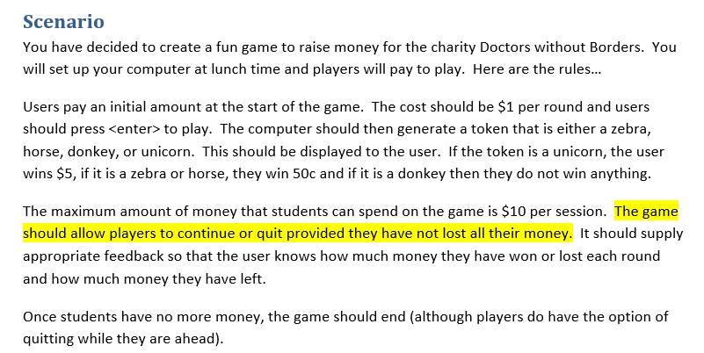
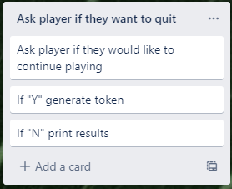
[Component name] (Trello screenshot)

Slide 24
[Component name] - Test Plan
Additional rows can be added by clicking in the last cell and then using the Tab key
Test Cases - input | Expected output
Notes:
Additional rows can be added by clicking in the last cell and then using the Tab key

Slide 25
[Component name]: Trialling
NOTE: Trialling needs to happen for at least 2 of your components but is not necessary for ALL components.
Trialling is not the same as testing. Trialling is about finding different ways of building the same component. Show evidence of your trialling here. Select one of your trials for further development and give reasons for your choice.
Notes:
NOTE: Trialling needs to happen for at least 2 of your components but is not necessary for ALL components.
Trialling is not the same as testing. Trialling is about finding different ways of building the same component. Show evidence of your trialling here. Select one of your trials for further development and give reasons for your choice.

Slide 26
[Component name]: Testing
You must show the results of testing. For each component, include a screenshot proving it works. You can also include notes about each test.
Notes:
You must show the results of testing. For each component, include a screenshot proving it works. You can also include notes about each test.

Slide 27
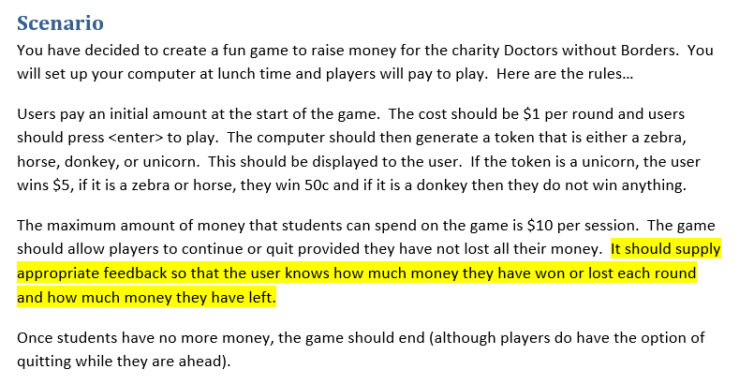
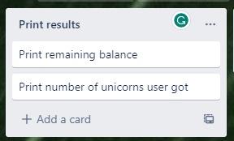
[Component name] (Trello screenshot)

Slide 28
[Component name] - Test Plan
Additional rows can be added by clicking in the last cell and then using the Tab key
Test Cases - input | Expected output
Notes:
Additional rows can be added by clicking in the last cell and then using the Tab key

Slide 29
[Component name]: Trialling
NOTE: Trialling needs to happen for at least 2 of your components but is not necessary for ALL components.
Trialling is not the same as testing. Trialling is about finding different ways of building the same component. Show evidence of your trialling here. Select one of your trials for further development and give reasons for your choice.
Notes:
NOTE: Trialling needs to happen for at least 2 of your components but is not necessary for ALL components.
Trialling is not the same as testing. Trialling is about finding different ways of building the same component. Show evidence of your trialling here. Select one of your trials for further development and give reasons for your choice.

Slide 30
[Component name]: Testing
You must show the results of testing. For each component, include a screenshot proving it works. You can also include notes about each test.
Notes:
You must show the results of testing. For each component, include a screenshot proving it works. You can also include notes about each test.

Slide 31
Assembled Outcome Testing:
Show testing for your assembled outcome below. This should include a test plan followed by screenshot proof.
Notes:
Show testing for your assembled outcome below. This should include a test plan followed by screenshot proof.

Slide 32
Address relevant Implications:
Relevant implication | Explain how your final outcome addresses each implication

Slide 33
Version Control Evidence:
Your version control evidence should go here. This could be in the form of screenshots (both of your GitHub repository as well as your local project folder) as evidence of your incremental development.
Notes:
Your version control evidence should go here. This could be in the form of screenshots (both of your GitHub repository as well as your local project folder) as evidence of your incremental development.

Slide 34
Final Discussion:
Discuss how the information from planning, testing and trialling of components assisted in the development of a high-quality outcome.
Notes:
Discuss how the information from planning, testing and trialling of components assisted in the development of a high-quality outcome.

